Slide 1

04 May 2021
Radford Burger

Slide 2
Agenda
Implementing a Queue using a Linked List
Other ways to implement queues
What’s next?
  → Hash tables

Slide 3

What is a Queue?
A queue is an ordered collection of items where the addition of new items happens at one end, called the “rear,” and the removal of existing items occurs at the other end, commonly called the “front.”
The first element to be inserted is the first one to be deleted.
Hence, it is called First in First out (FIFO) or Last in Last out (LILO) list.

Slide 4
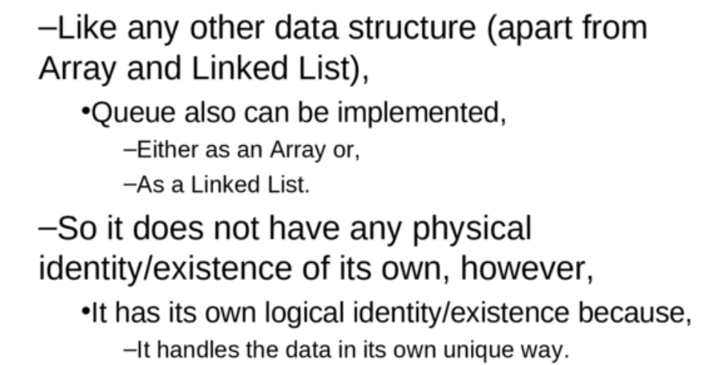
What is a Queue?

Slide 5
Queue operations
add(): Which adds a single element at the rear of a queue
Also known as: Enqueue
remove(): Which removes a single element from the front of a queue.
Also known as: Dequeue
peek() or front() or first(): examine front element without removing it
isEmpty(): Returns 1(true) if the queue is empty
size(): Returns the number of elements in a queue.

Slide 6
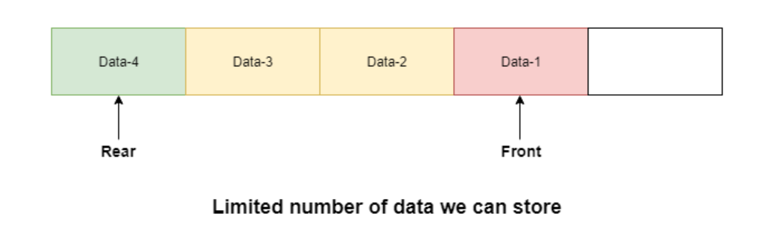
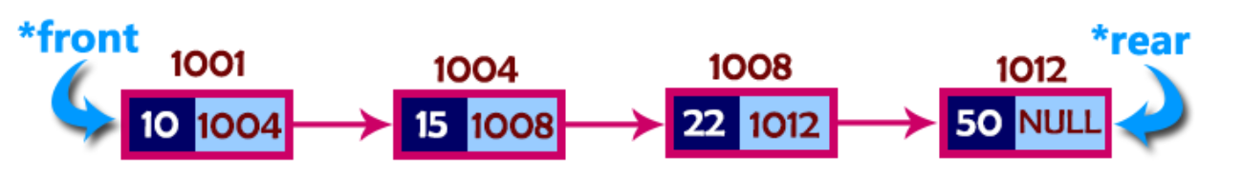
Implementation of Queue using Linked List
Queue array
Queue Linked list

Slide 7
Why use Linked List?
The major problem with the queue implemented using array is, It will work for only fixed number of data values. That means, the amount of data must be specified in the beginning itself.
Queue using array is not suitable when we do not know the size of data which we are going to use.
The queue which is implemented using linked list can work for unlimited number of values.
That means, queue using linked list can work for variable size of data (No need to fix the size at beginning of the implementation).
The Queue implemented using linked list can organize as many data values as we want.

Slide 8
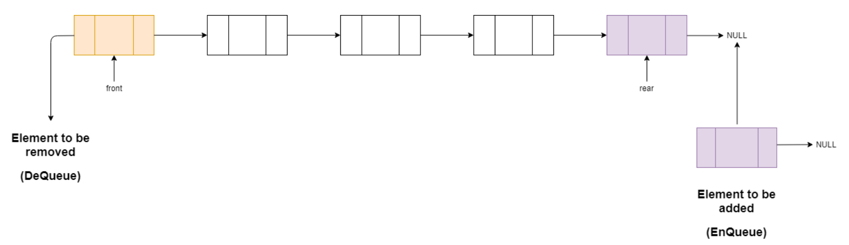
Implementation of Queue using Linked List
you only have to manipulate FRONT and REAR to get Queue properties

Slide 9
Implementation of Queue using Linked List
Array implementation | Linked List implementation
public class Queue {
private int size;
private int Capacity=10;
private int[] data;
int front=0;
int back=-1;
public Queue() {
size = 0;
data = new int[Capacity];
}
//other methods
}//end class
public class Queue {
private static class Node {
private int data;
private Node next;
public Node( int v, Node n) {
data = v;
next = n;
}
}//end class Node
private Node front = null;
private Node rear = null;
private int size = 0;
//other methods.
}//end class Queue
Set number of elements in queue to zero.
Set front of queue to zero.
Set back of queue to -1.
Set size of list queue to zero.
Set head (front) of list to null.
Set tail (rear) of list to null.

Slide 10
Queue Linked list Operations in action
https://www.cs.usfca.edu/~galles/visualization/QueueLL.html
Play around with this visualization application:
https://visualgo.net/en/list

Slide 11
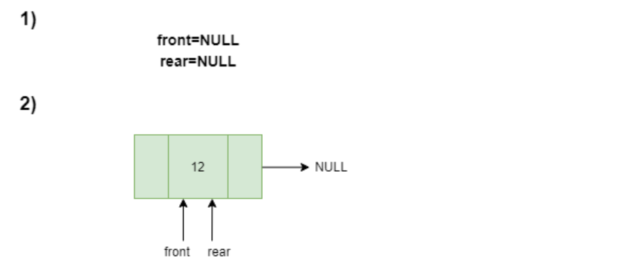

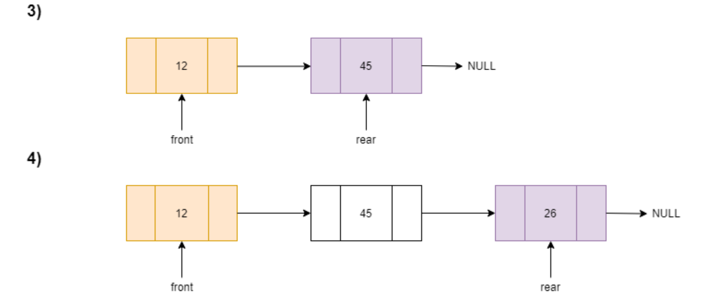
Algorithm to Add element to Queue Linked list
New Node
Add another node
Add another node

Slide 12
Algorithm to Add element to Queue Linked list
enqueue() : insert one element at the rear of the queue.
Step 1 - Create a newNode with given value and set 'newNode → next' to NULL.
Step 2 - Check whether queue is Empty (rear == NULL)
Step 3 - If it is Empty then, set front = newNode and rear = newNode.
Step 4 - If it is Not Empty then, set rear → next = newNode,
and rear = newNode.
Step 5 - increment size of queue.

Slide 13
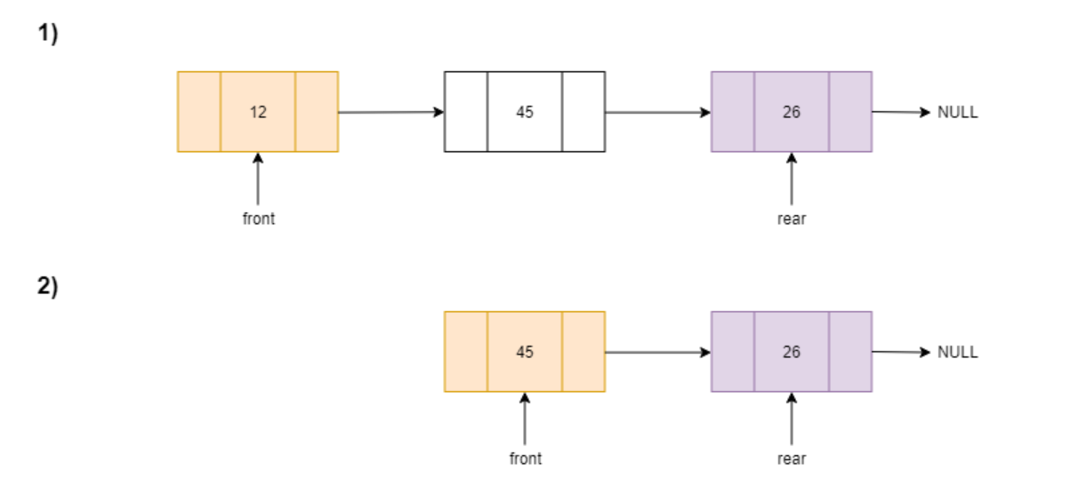
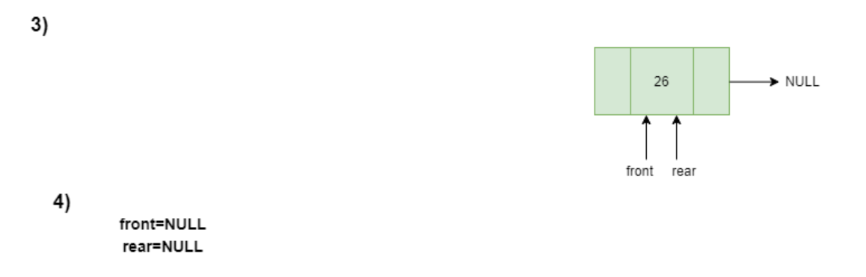
Algorithm to Remove element from Queue Linked List

Slide 14
Algorithm to Remove element from Queue Linked List
dequeue() : delete one element from the front of the queue.
Step 1 - Check whether queue is Empty (front == NULL).
Step 2 - If it is Empty, then display "Queue is Empty!!! Deletion is not possible!!!" and terminate from the function
Step 3 - If it is Not Empty then, define a Node pointer 'temp' and set it to 'front'.
Step 4 - Then set 'front = front → next' and delete 'temp' (free(temp)).
Step 5 - decrement size of queue.

Slide 15
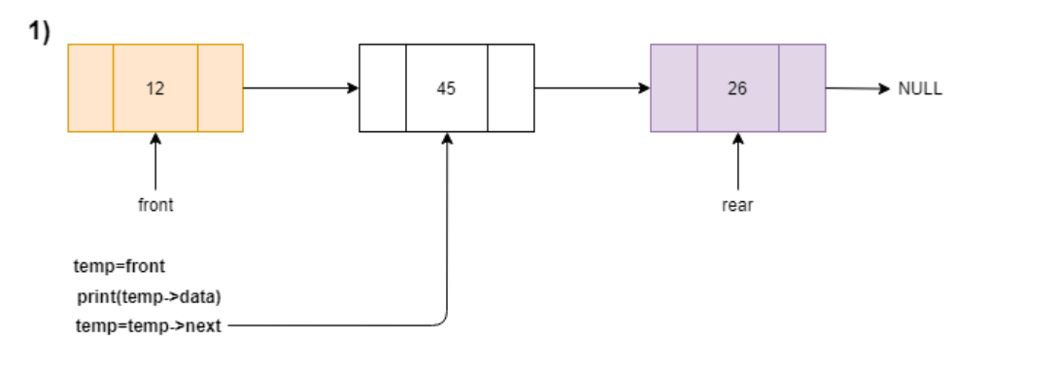
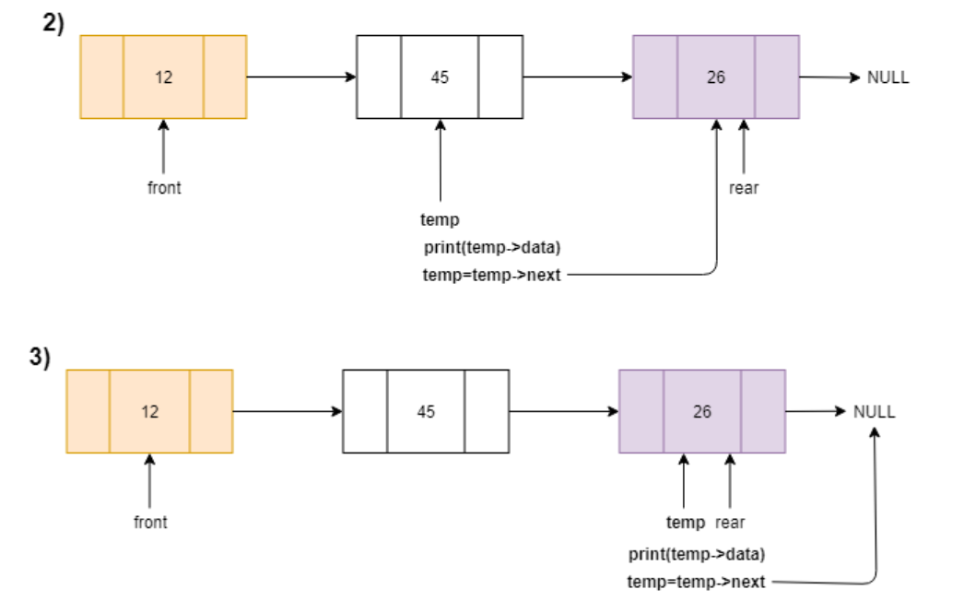
Algorithm to display all elements of Queue Linked List

Slide 16
Algorithm to display all elements of Queue Linked List
display() : display all elements of the queue.
Step 1 - Check whether queue is Empty (front == NULL).
Step 2 - If it is Empty then, display 'Queue is Empty!!!' and terminate the function.
Step 3 - If it is Not Empty then, define a Node pointer 'temp' and initialize with front.
Step 4 - Display 'temp → data --->' and move it to the next node. Repeat the same until 'temp' reaches to 'rear' (temp → next != NULL).
Step 5 - Finally! Display 'temp → data ---> NULL'.

Slide 17
Complexity of Queue Linked List operations
Is enqueue operation O(1) or O(n) time complexity?
Is dequeue operation O(1) or O(n) time complexity?
Why?

Slide 18
How else can a Queue be implemented?
A Queue is defined by its property of FIFO, which means First in First Out, i.e the element which is added first is taken out first.
This behaviour defines a queue, whereas data is actually stored in an array or a list in the background.
What we mean here is that no matter how and where the data is getting stored, if the first element added is the first element being removed and we have implementation of the functions enqueue() and dequeue() to enable this behaviour, we can say that we have implemented a Queue data structure

Slide 19
Using a Stack to implement a Queue
We have to consider the natural behaviour of stack is First in Last Out.
For performing enqueue we can directly push data onto the stack.
To perform dequeue and we directly pop any data element out of Stack, it will follow LIFO approach(Last in First Out).

Slide 20
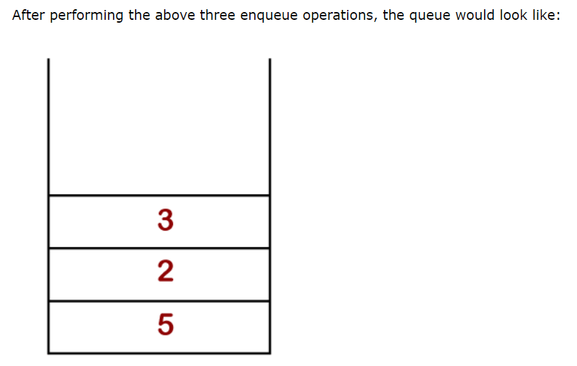
Using a Stack to implement a Queue
Now we will perform three enqueue operations shown as below:
enqueue(5);
enqueue(2);
enqueue(3);

Slide 21
Using a Stack to implement a Queue
In the stack below, we can observe that the topmost element is 3.
If we perform the delete (pop) operation in the stack, then the element 3 would be deleted from the stack.
However, the deletion in Queue is performed from the front end and the front element is 5.
In order to implement the Queue using Stack, we need to consider two stacks.

Slide 22
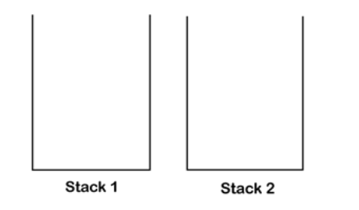
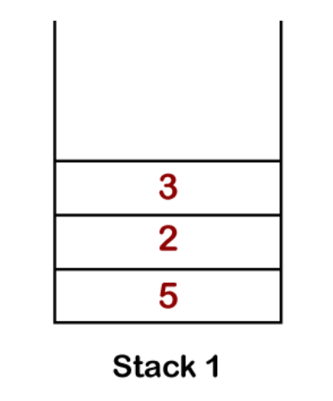
Using 2 Stacks to implement a Queue
As we can observe, both stacks are empty.
Now, we will perform push operations on Stack1.
First, we will push 5, then 2 and finally we will push element 3 as shown :

Slide 23
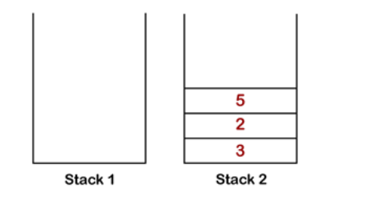
Using 2 Stacks to implement a Queue
Now we will pop the elements from Stack1,
one by one, and push them into the Stack2

Slide 24
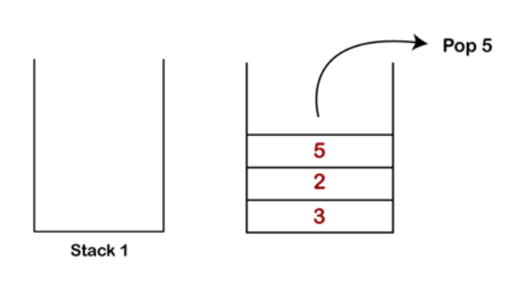
Using 2 Stacks to implement a Queue
Stack 2
Once the elements are inserted into the Stack2, the topmost element is 5, so it would be popped out from the Stack 2

Slide 25
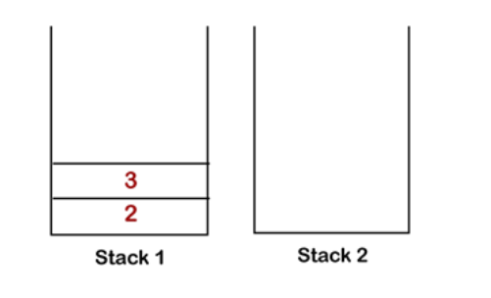
Using 2 Stacks to implement a Queue
Stack 2
Once the topmost element is popped out from the Stack2, all the elements are moved back from Stack2 to Stack 1

Slide 26
Using Stacks to implement a Queue
When using two Stacks to implement a queue:
We can follow two approaches:
By making the enqueue operation costly
By making the dequeue operation costly
We will investigate this during next class

Slide 27
Next week?
  → Hash tables

Slide 28

DATE CHANGE
Class test: Wednesday 19 May 2021
Doubly and circular Linked Lists
Stacks
Queues

Slide 29
DATE CHANGE
Class test: Wednesday 19 May 2021
Timetable change: only ONE class scheduled per week.
Wednesdays @ 9am
Any students registered for Prof Prac 3 need to contact me ASAP, via email.
Using this possible clash as excuse for missing test will NOT BE ACCEPTED.

